Slide 1
Database Management System

Slide 2
Contents
Need of Normalization
Types of Normalization
How we can find the highest normal form of a relation?

Slide 3
Data Normalization
Primarily a tool to validate and improve a logical design so that it satisfies certain constraints that avoid unnecessary duplication of data.
The process of decomposing relations with anomalies to produce smaller, well-structured relations.

Slide 4
Well-Structured Relations
A relation that contains minimal data redundancy and allows users to insert, delete, and update rows without causing data inconsistencies
Goal is to avoid anomalies
  Insertion Anomaly–adding new rows forces user to create duplicate data.
  Deletion Anomaly–deleting rows may cause a loss of data that would be needed for other future rows.
  Modification Anomaly–changing data in a row forces changes to other rows because of duplication.
General rule of thumb: A table should not pertain to more than one entity type

Slide 5
STUDENT
RN | Name | Age | B_ID | B_Name | HOD | Ph.
1 | A | 20 | 101 | CS | XYZ | 123
2 | B | 21 | 101 | CS | XYZ | 123
3 | C | 18 | 102 | IT | PQR | 456
4 | D | 20 | 102 | IT | PQR | 456
5 | E | 22 | 101 | CS | XYZ | 123
Insertion Anomaly
Updation Anomaly
Deletion Anomaly

Slide 6
STUDENT
BRANCH
RN | Name | Age | B_ID
1 | A | 20 | 101
2 | B | 21 | 101
3 | C | 18 | 102
4 | D | 20 | 102
5 | E | 22 | 101
B_ID | B_Name | HOD | Ph.
101 | CS | XYZ | 123
102 | IT | PQR | 456
Insertion Anomaly
Updation Anomaly
Deletion Anomaly

Slide 7
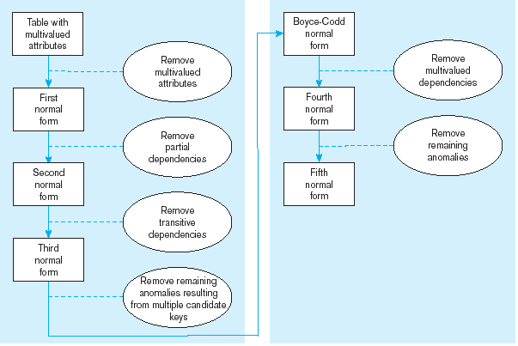
Steps in normalization

Slide 8
First Normal Form
No multivalued attributes
Every attribute value is atomic
Fig. 5-25 is not in 1st Normal Form (multivalued attributes) ➔ it is not a relation
Fig. 5-26 is in 1st Normal form
All relations are in 1st Normal Form

Slide 9
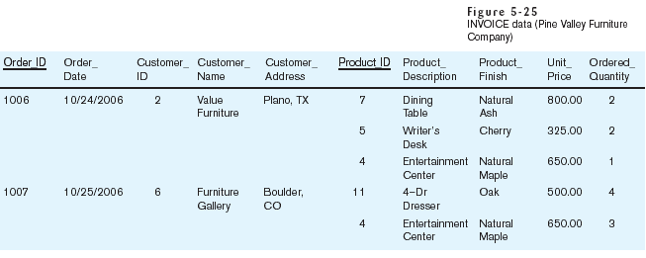
Table with multivalued attributes, not in 1st normal form

Slide 10
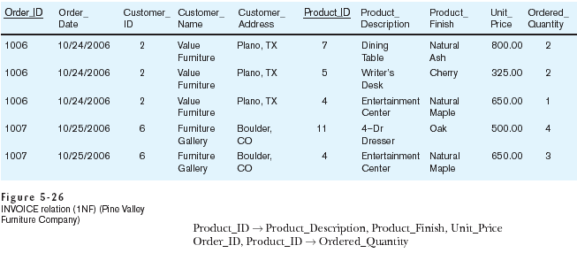
Table with no multivalued attributes and unique rows, in 1st normal form
Note: this is relation, but not a well-structured one

Slide 11
Anomalies in this Table
Insertion–if new product is ordered for order 1007 of existing customer, customer data must be re-entered, causing duplication
Deletion–if we delete the Dining Table from Order 1006, we lose information concerning this item's finish and price
Update–changing the price of product ID 4 requires update in several records
Why do these anomalies exist?
  Because there are multiple themes (entity types) in one relation. This results in duplication and an unnecessary dependency between the entities

Slide 12
Second Normal Form
1NF PLUS every non-key attribute is fully functionally dependent on the ENTIRE primary key
  Every non-key attribute must be defined by the entire key, not by only part of the key
  No partial functional dependencies

Slide 13
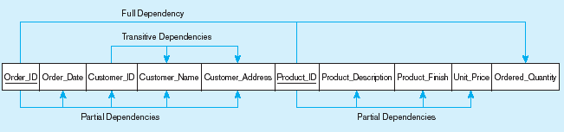
Figure : Functional dependency diagram for INVOICE
Order_ID ➔ Order_Date, Customer_ID, Customer_Name, Customer_Address
Customer_ID ➔ Customer_Name, Customer_Address
Product_ID ➔ Product_Description, Product_Finish, Unit_Price
Order_ID, Product_ID ➔ Order_Quantity
Therefore, NOT in 2nd Normal Form

Slide 14
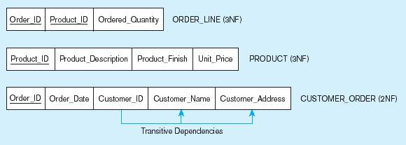
Figure: Removing partial dependencies
Getting it into Second Normal Form
Partial dependencies are removed, but there are still transitive dependencies

Slide 15
Third Normal Form
2NF PLUS no transitive dependencies (functional dependencies on non-primary-key attributes)
Note: This is called transitive, because the primary key is a determinant for another attribute, which in turn is a determinant for a third
Solution: Non-key determinant with transitive dependencies go into a new table; non-key determinant becomes primary key in the new table and stays as foreign key in the old table

Slide 16
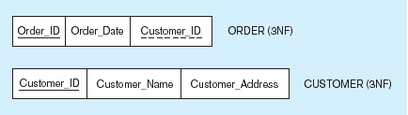
Figure: Removing partial dependencies
Getting it into Third Normal Form
Transitive dependencies are removed

Slide 17
Thanks

